Slide 1
Index structures/files
B⁺- Tree
B-Tree
Notes:
1

Slide 2
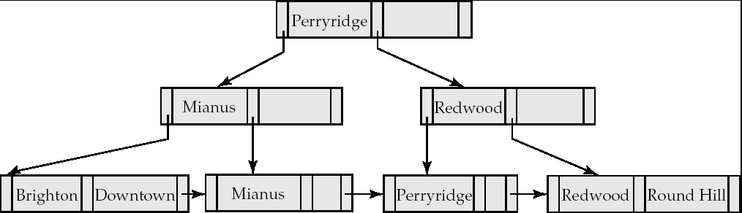
B⁺-Tree Index
A B⁺-tree is a rooted tree satisfying the following properties:
All paths from root to leaf are of the same length
Each node that is not a root or a leaf has between ⎡n/2⎤ and n children. [Non leaf node]
A leaf node has between ⎡(n–1)/2⎤ and n–1 values
Special cases:
If the root is not a leaf, it has at least 2 children.
If the root is a leaf (that is, there are no other nodes in the tree), it can have between 0 and (n–1) values.

Slide 3
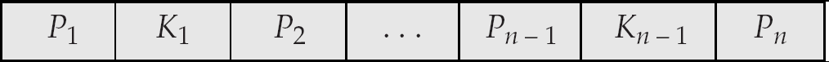
B⁺-Tree Node Structure
Typical node
K_{i} are the search-key values
P_{i} are pointers to children (for non-leaf nodes) or pointers to records or buckets of records (for leaf nodes).
The search-keys in a node are ordered
K₁ < K₂ < K₃ < . . . < K_{n–1}

Slide 4
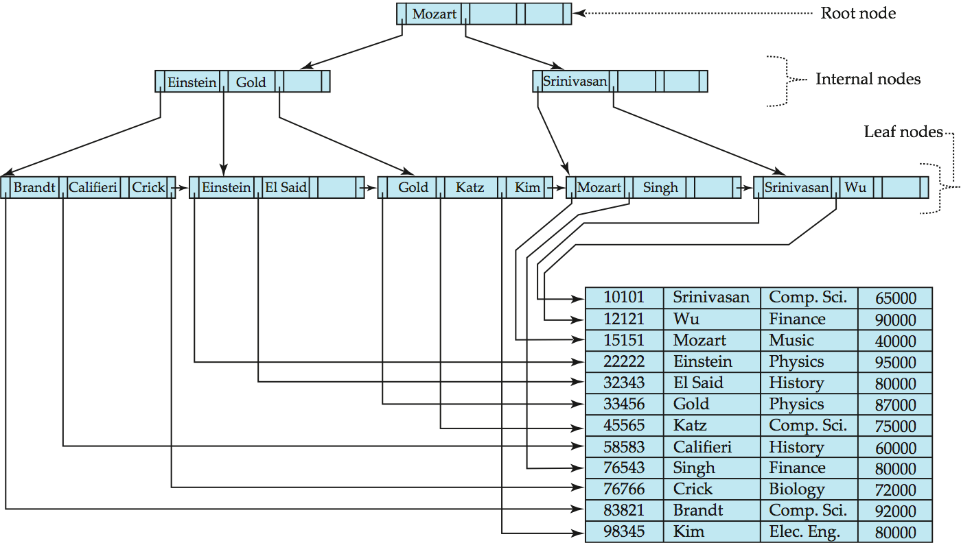
Example of B⁺-Tree

Slide 5
Updates on B⁺-Trees: Insertion (Cont.)
Splitting a leaf node:
take the n (search-key value, pointer) pairs (including the one being inserted) in sorted order. Place the first ⎡n/2⎤ in the original node, and the rest in a new node.
let the new node be p, and let k be the least key value in p. Insert (k,p) in the parent of the node being split.
If the parent is full, split it and propagate the split further up.
Splitting of nodes proceeds upwards till a node that is not full is found.
In the worst case the root node may be split increasing the height of the tree by 1.
Result of splitting node containing Brandt, Califieri and Crick on inserting Adams
Next step: insert entry with (Califieri,pointer-to-new-node) into parent

Slide 6
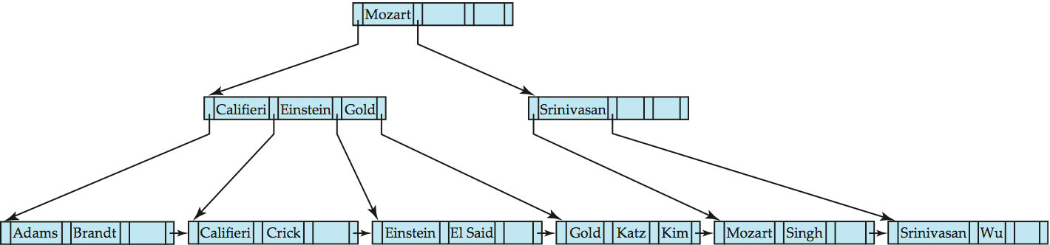
B⁺-Tree Insertion
B⁺-Tree before and after insertion of “Adams”

Slide 7
Insertion in B⁺-Trees (Cont.)
Splitting a non-leaf node: when inserting (k,p) into an already full internal node N
Copy N to an in-memory area M with space for n+1 pointers and n keys
Insert (k,p) into M
Copy P₁,K₁, …, K _{⎡n/2⎤-1},P _{⎡n/2⎤} from M back into node N
Copy P_{⎡n/2⎤+1},K _{⎡n/2⎤+1},…,K_{n},P_{n+1} from M into newly allocated node N’
Insert (K _{⎡n/2⎤},N’) into parent N
Read pseudocode in book!
Califieri
Adams Brandt Califieri Crick
Adams Brandt
Crick

Slide 8
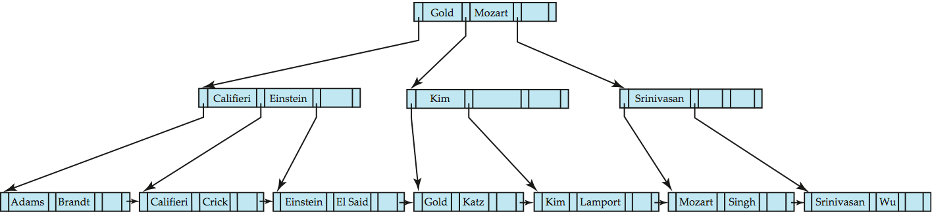
B⁺-Tree before and after insertion of “Lamport”

Slide 9
Dynamic Multilevel Indexes Using B-Trees and B+-Trees
Because of the insertion and deletion problem, most multi-level indexes use B-tree or B+-tree data structures, which leave space in each tree node (disk block) to allow for new index entries
These data structures are variations of search trees that allow efficient insertion and deletion of new search values.
In B-Tree and B+-Tree data structures, each node corresponds to a disk block
Each node is kept between half-full and completely full

Slide 10
Dynamic Multilevel Indexes Using B-Trees and B+-Trees (contd.)
An insertion into a node that is not full is quite efficient; if a node is full the insertion causes a split into two nodes
Splitting may propagate to other tree levels
A deletion is quite efficient if a node does not become less than half full
If a deletion causes a node to become less than half full, it must be merged with neighboring nodes

Slide 11
Difference between B-tree and B+-tree
In a B-tree, pointers to data records exist at all levels of the tree
In a B+-tree, all pointers to data records exists at the leaf-level nodes
A B+-tree can have less levels (or higher capacity of search values) than the corresponding B-tree

Slide 12
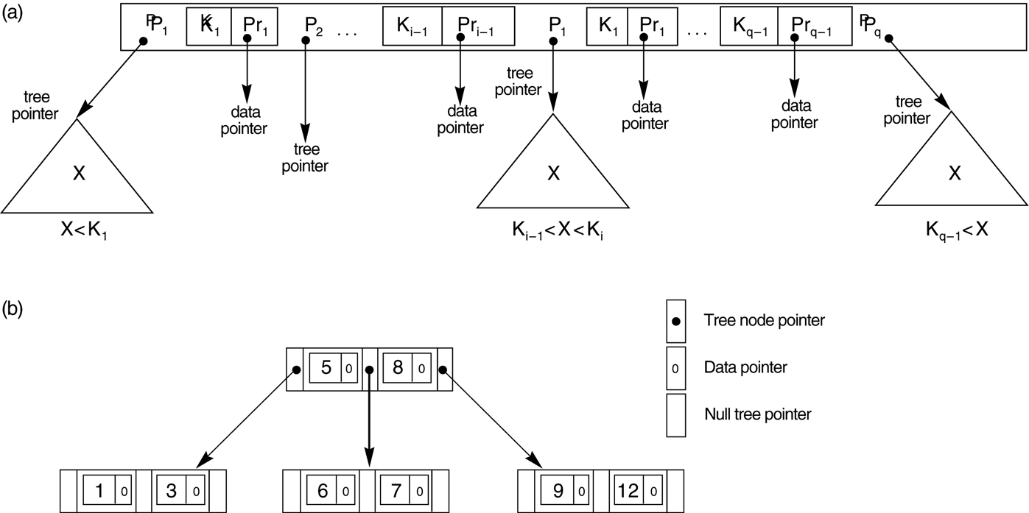
B-tree structures. (a) A node in a B-tree with q – 1 search values. (b) A B-tree of order p = 3. The values were inserted in the order 8, 5, 1, 7, 3, 12, 9, 6.

Slide 13
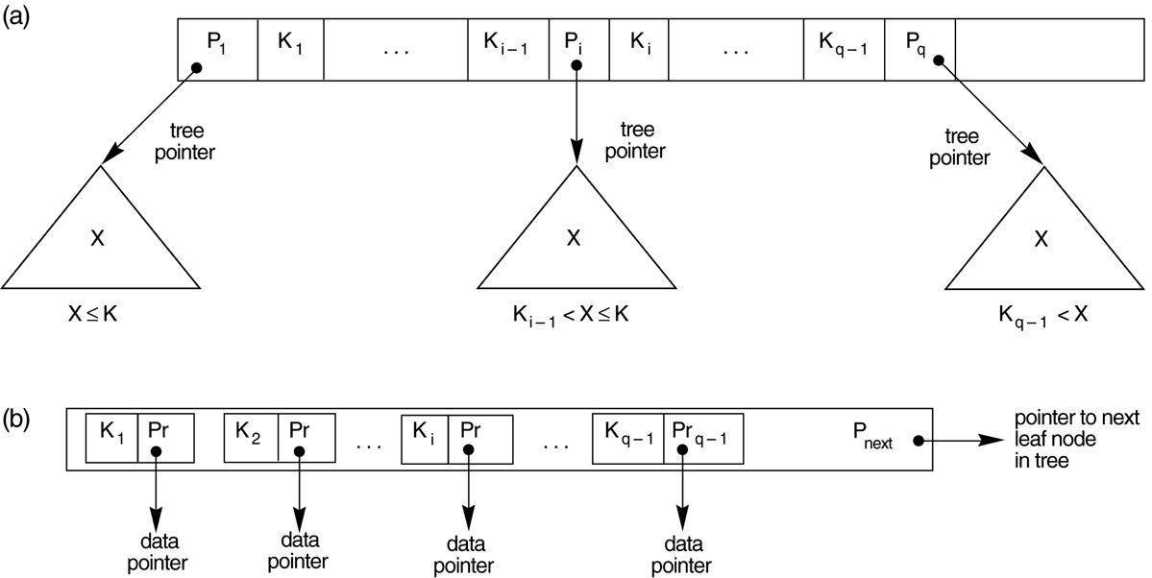
The nodes of a B+-tree. (a) Internal node of a B+-tree with q –1 search values. (b) Leaf node of a B+-tree with q – 1 search values and q – 1 data pointers.

Slide 14
Observations about B⁺-trees
Since the inter-node connections are done by pointers, “logically” close blocks need not be “physically” close.
The non-leaf levels of the B⁺-tree form a hierarchy of sparse indices.
The B⁺-tree contains a relatively small number of levels
Level below root has at least 2* ⎡n/2⎤ values
Next level has at least 2* ⎡n/2⎤ * ⎡n/2⎤ values
.. etc.
If there are K search-key values in the file, the tree height is no more than ⎡ log_{⎡n/2⎤}(K)⎤
thus searches can be conducted efficiently.
Insertions and deletions to the main file can be handled efficiently, as the index can be restructured in logarithmic time.

Slide 15
Queries on B⁺-Trees
Find all records with a search-key value of k.
N=root
Repeat
Examine N for the smallest search-key value > k.
If such a value exists, assume it is K_{i}. Then set N = P_{i}
Otherwise k ≥ K_{n–1}. Set N = P_{n}
Until N is a leaf node
If for some i, key K_{i} = k follow pointer P_{i} to the desired record or bucket.
Else no record with search-key value k exists.

Slide 16
Example B+ Tree
Search begins at root, and key comparisons direct it to a leaf.
Search for 5*, 15*, all data entries >= 24* ...
Root
13
17
24
30
2*
3*
5*
7*
14*
16*
19*
20*
22*
24*
27*
29*
33*
34*
38*
39*
Based on the search for 15*, we know it is not in the tree!
Notes:
10

Slide 17
Query on B+ Trees
In processing a query, a path is traversed in the tree from the root to some leaf node.
If there are K search-key values in the file, the path is no longer than
A node is generally the same size as a disk block, typically 4 kilobytes, and n is typically around 100 (40 bytes per index entry).
With 1 million search key values and n = 100, at most
log₅₀(1,000,000) = 4 nodes are accessed in a lookup.
Contrast this with a balanced binary tree with 1 million search key values — around 20 nodes are accessed in a lookup
above difference is significant since every node access may need a disk I/O, costing around 20 milliseconds!

Slide 18
B+ Trees in Practice
Typical order: 100. Typical fill-factor: 67%.
average fanout = 133
Typical capacities:
Height 4: 133⁴ = 312,900,700 records
Height 3: 133³ = 2,352,637 records
Can often hold top levels in buffer pool:
Level 1 = 1 page = 8 Kbytes
Level 2 = 133 pages = 1 Mbyte
Level 3 = 17,689 pages = 133 MBytes

Slide 19
Inserting a Data Entry into a B+ Tree
Find correct leaf L.
Put data entry onto L.
If L has enough space, done!
Else, must split L (into L and a new node L2)
Redistribute entries evenly, copy up middle key.
Insert index entry pointing to L2 into parent of L.
This can happen recursively
To split index node, redistribute entries evenly, but push up middle key. (Contrast with leaf splits.)
Splits “grow” tree; root split increases height.
Tree growth: gets wider or one level taller at top.
Notes:
6

Slide 20
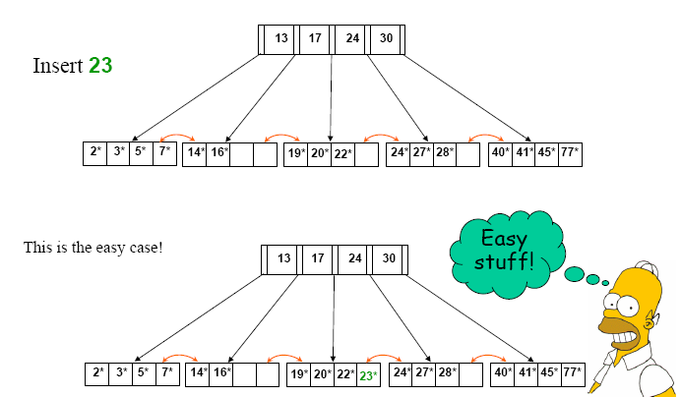

Slide 23
Inserting 8* into Example B+ Tree
Observe how minimum occupancy is guaranteed in both leaf and index pg splits.
Note difference between copy-up and push-up; be sure you understand the reasons for this.
Entry to be inserted in parent node.
5
(Note that 5 is
s copied up and
continues to appear in the leaf.)
2*
3*
5*
7*
8*
Entry to be inserted in parent node.
17
(Note that 17 is pushed up and only
appears once in the index. Contrast
this with a leaf split.)
5
13
24
30
Notes:
12

Slide 24
Example B+ Tree After Inserting 8*
Root
17
5
13
24
30
2*
3*
5*
7*
8*
14*
16*
19*
20*
22*
24*
27*
29*
33*
34*
38*
39*
Notice that root was split, leading to increase in height.
In this example, we can avoid split by re-distributing entries; however, this is usually not done in practice.
Notes:
13

Slide 25
Deleting a Data Entry from a B+ Tree
Start at root, find leaf L where entry belongs.
Remove the entry.
If L is at least half-full, done!
If L has only d-1 entries,
Try to re-distribute, borrowing from sibling (adjacent node with same parent as L).
If re-distribution fails, merge L and sibling.
If merge occurred, must delete entry (pointing to L or sibling) from parent of L.
Merge could propagate to root, decreasing height.
Notes:
14

Slide 26
Example Tree After (Inserting 8*, Then) Deleting 19* and 20* ...
Root
17
5
13
27
30
2*
3*
5*
7*
8*
14*
16*
22*
24*
27*
29*
33*
34*
38*
39*
Deleting 19* is easy.
Deleting 20* is done with re-distribution. Notice how middle key is copied up.
Notes:
15

Slide 27
... And Then Deleting 24*
Must merge.
Observe `toss’ of index entry (on right), and `pull down’ of index entry (below).
30
22*
27*
29*
33*
34*
38*
39*
Root
5
13
17
30
2*
3*
5*
7*
8*
14*
16*
22*
27*
29*
33*
34*
38*
39*
Notes:
16

